Slide 1
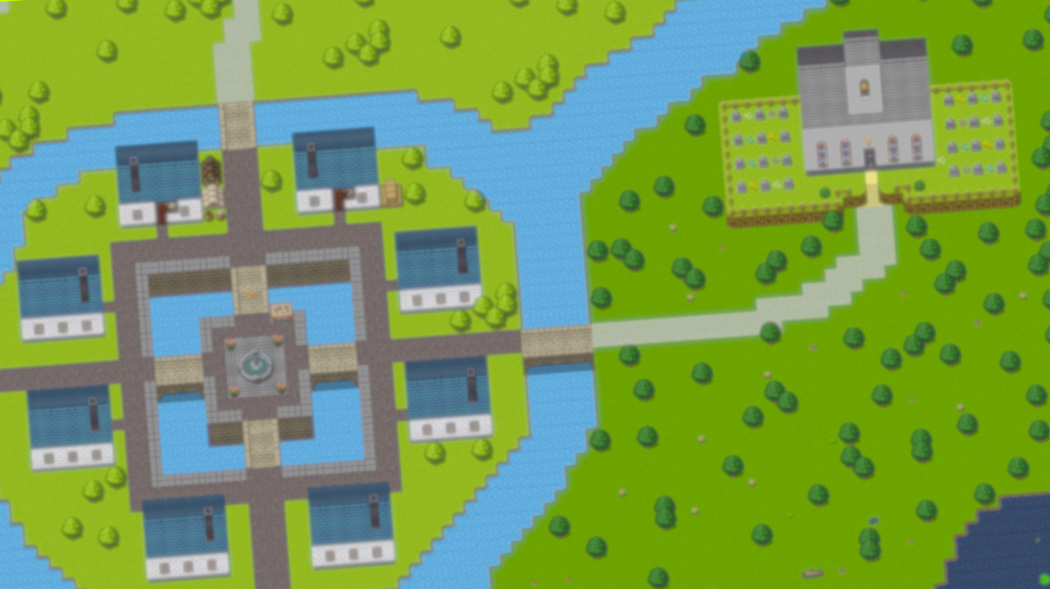

A Massively Multiplayer Online Game Facilitating Communication Skill Development
Robert Pringle (2304777P)
Notes:
Hi my name is Robert Pringle and today I am going to present to you my final year project for computing Science at the Univ esity of Glasgow titled

Slide 2
Overview
Motivation
Aims
Design
Demo walk through
Key implementation details summary
Alpha Testing Evaluation
Beta Testing Evaluation
Future work
Conclusion
References provided at end

Slide 3
Main Motivations
Video games are a huge industry, and even overtaken the entertainment industry in revenue [1].
Barr (2017) showed video games can develop skills which would benefit employability and workplace performance, with a focus communication skills [2].
Universities are currently failing to provide a method to develop such skills [3].

Slide 4
Aims
Create a multiplayer browser game that facilitates students development of communication
Evaluate the usability and playability of the game
Investigate if student participants believe Explore MMO develops communication skills
Investigate students attitudes towards Explore MMO being implemented into their curriculum

Slide 5
Requirements
MosCoW method of prioritization
Created based of background research and supervisor meetings
29 requirements created in total
Core requirements:
Users must be able to complete quests which require communication
Users must be able to complete quests which encourage communication
Users must have the ability to communicate using a text-based chat
Users must be able to see other players’ movements in real time
Users must be able to explore a virtual world

Slide 6
Design
The game went through a detailed design process
Designing different user interfaces and the map prior to implementation
More information can be seen in Chapter 4 of the dissertation

Slide 7
Quest Design
Designed using background research
Two types of quest derived:
Quests which force communication to succeed
Quests that encourage communication to succeed
Keep Talking and Nobody Explodes forces player to communicate and has been shown to develop communication skills [4].
Harder a task is in a video game the more likely people are to work together [5].
Five quests created in total

Slide 8
Demo

Slide 9
Key Implementation Details Summary
Game chat as shown in demo
Continuous data streaming handles real-time movement with web sockets
Players can complete quests together
Phaser game framework used for implementation
Node.js and Express to handle the backend and send games files straight to client
Copyright free game assets
NoSQL MongoDB database

Slide 10
Alpha Testing Evaluation
Carried out early in the development
Student participants played game with a random other participants
System Usability Scale survey given to participants to measure usability of early prototype and scored an average of 80/100
Semi-structured interview were then carried out to investigate:
If any bugs were identified
Potential improvement to add
Helped identify bugs early and gather more requirements

Slide 11
Beta Testing Evaluation
Carried out at the end of the project
They were ask to play through the completed game for a minimum of 30 minutes
All students played longer, suggesting the game is engaging
System Usability Scale survey saw an increase of 9.5 from the Alpha evaluation meaning a score of 89.5/100.
Online form used instead of interview:
Participants believed the game was fun
Only trivial bugs identified
Students believed that Explore MMO was developing their communication skills
Students were positive about the idea of Explore MMO being used in their curriculum

Slide 12
Future Work
Implement rewards for completing quests
Implement procedurally generated quests
Carry out beta evaluation study with random participants and a larger participant sample size and see if results still hold true
Carry out a longitudinal study to see if Explore MMO develops communication skills

Slide 13
Conclusion
Explore MMO is a fun, engaging and highly usable prototype which facilitates communication development between players
Evaluation showed participants believed their communication skill was developed using the application
Evaluation also showed participants were positive about using Explore MMO in their curriculum

Slide 14
Questions?
Personal email: pringle@live.co.uk
Student email: 2304777P@student.gla.ac.uk

Slide 15
References
[1] Statista. Gaming: The Most Lucrative Entertainment Industry By Far. Statista Infographics, 2020. See URL https://www.statista.com/chart/22392/global
[2] M. Barr. Video games can develop graduate skills in higher education students: A randomised trial. Computers & Education, pages 86–97, 2017. URL https://www.sciencedirect.com/science/article/pii/S0360131517301215.
[3] CBI. Education and learning for the modern world: Cbi/pearson 2019 education and skills survey report. CBI, 2019.
URL https://www.cbi.org.uk/articles/education-and-learning-for-the-modern-world/.
[4] L. Tidbury, K. Jarvis, and P. Bridge. Initial evaluation of a virtual reality bomb-defusing simulator for development of undergraduate healthcare student communication and teamwork skills. BMJ Simulation and Technology Enhanced Learning, 6:229–231, 2020.
doi: 10.1136/bmjstel-2019-000446. URL https://stel.bmj.com/content/6/4/229
[5] C.-I. Teng, M.-Y. Chen, Y.-J. Chen, and Y.-J. Li. Loyalty Due to Others: The Relationships Among Challenge, Interdependence, and Online Gamer Loyalty. Journal of Computer-Mediated Communication, 17(4):489–500, 2012. ISSN 1083-6101. doi:10.1111/j.1083-6101.2012. 01586.x. URL https://doi.org/10.1111/j.1083-6101.2012.01586.x. _eprint:
https://academic.oup.com/jcmc/article-pdf/17/4/489/22317557/jjcmcom0489.pdf
.

